Slide 1
Pembelajaran Mesin dan Pembelajaran Mendalam #2 Model Training and Evaluation
Semester Gasal 2024/2025
Prodi Informatika
Universitas Atma Jaya Yogyakarta

Slide 2
Outline
Model Preparation
Preprocessing
Data Scaling
Feature Selection
Modelling
Grid Search
Cross Validation
Pipeline
Model Evaluation
Evaluation Metrics

Slide 3

A little reminder

Slide 4
(simple) Model training and testing
A portion of the complete dataset is used as the train set (usually 70-75%), the rest as test set (30-25%).
The process of dividing a dataset is called train-test split and is important for preparation model learning.
For classification cases, data and targets are separated before train-test split.
Train set is called as X_train, train label is called as y_train, test set is called as X_test, and the test label is referred to as y_test.

Slide 5
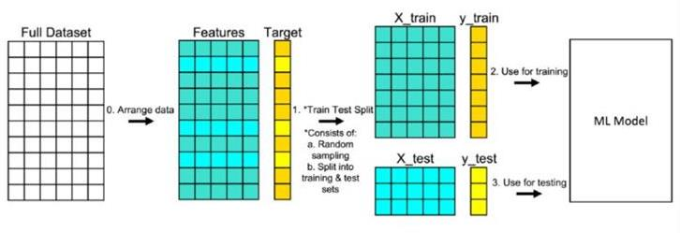

Slide 6
Data Cleansing

Slide 7
Data Cleansing
The dataset's data collection is not always in perfect shape.
Missing values are those in the data that are absent or do not exist.
Missing values are represented in Python by NaN or None.
The float data type has a missing value known as NaN (Not a Number).
Python's NoneType class contains the object none. None will immediately be converted to NaN in a Pandas DataFrame (changing the feature's existing data type).

Slide 8
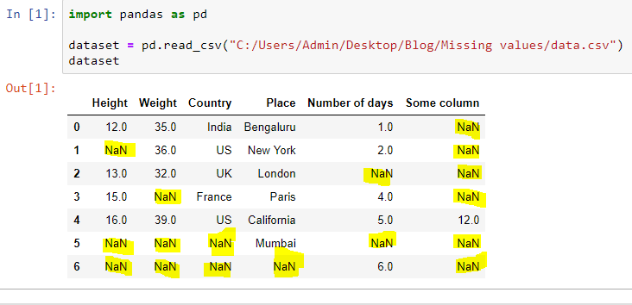
Missing data
https://www.datasciencesmachinelearning.com/2018/11/handling-missing-values-in-python.html

Slide 9
Missing value handling
The machine learning model's performance will be impacted by missing values.
The following options are available for handling missing values:
1. Discard samples that have values missing.
2. Manually enter any missing values.
3. Use data centering metrics like mean, median, and mode to fill in missing numbers.
4. Use machine learning models like regression, decision trees, KNN, etc. to fill in the values.

Slide 10
Python Tutorial: What is data preprocessing?
https://youtu.be/4i9aiTjjxHY?si=-o5ZWPosDuGkMnb7
Python Missing Data Filling Techniques - Simple Methods To Handle Missing Values
https://youtu.be/9ARreeMweNM?si=Z072cfv8DJVecS9U

Slide 11
Categorical Data Encoding

Slide 12
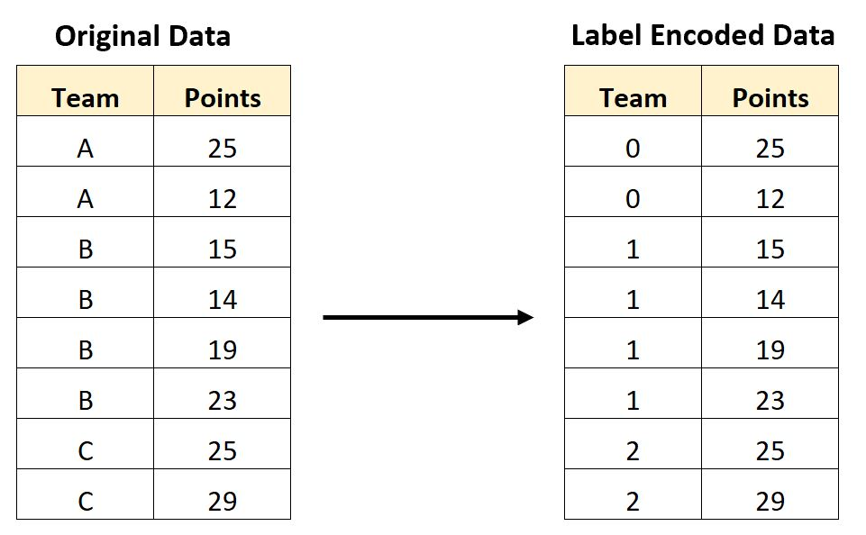
Categorical data encoding: label
Although the majority of scikit-learn estimators for classification internally convert class labels to integers, it is best practice to supply class labels as integer arrays to prevent technical issues.
https://www.statology.org/label-encoding-in-python/

Slide 13
Categorical data encoding: nominal features
We used the handy LabelEncoder to convert the string labels into integers because scikit-learn's estimators for classification treat class labels as categorical data that do not imply any order (nominal).
But, how about this?
blue = 0
green = 1
red = 2

Slide 14
Categorical data encoding: nominal features
blue = 0
green = 1
red = 2
Do you recognize the issue? Even though the color values are not arranged in any particular sequence, popular classification models will now assume that green is larger than blue and red is larger than green.
A classifier might still come up with meaningful findings. However, those outcomes would not be ideal.

Slide 15
Categorical data encoding: One-hot encoding
One-hot encoding is a method that is frequently used as a solution to this issue.
For each distinct value in the nominal feature column, a new dummy feature is supposed to be created using this method.
The color feature would be changed into the new features of blue, green, and red in this case.
A blue, for instance, can be expressed as blue=1, green=0, and red=0 using binary numbers to denote its specific color.

Slide 16
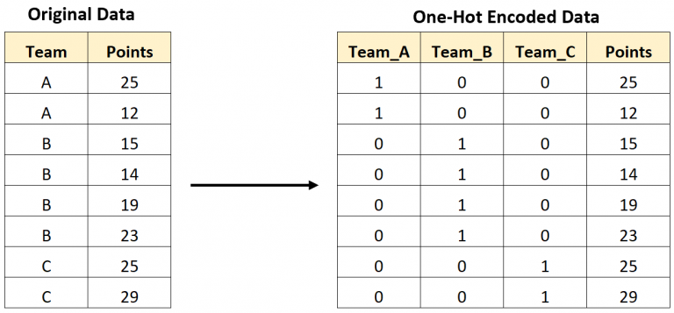
One-hot encoding example
https://www.statology.org/one-hot-encoding-in-python/

Slide 17
Handling Categorical Data in Machine Learning: Easy Explanation for Data Science Interviews
https://youtu.be/ERGzjB8U4aQ?si=1OIfpd-5Y2V8yza_

Slide 18
Data Scaling

Slide 19
Feature scaling
The majority of machine learning and optimization algorithms perform significantly better when features are scaled similarly.
Ex: k-nearest neighbors (KNN) technique with a Euclidean distance measure: the second feature axis will dominate the computed distances between samples.
We don't have to worry about feature scaling in decision trees and random forests.

Slide 20
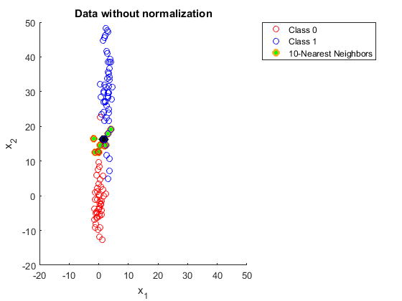
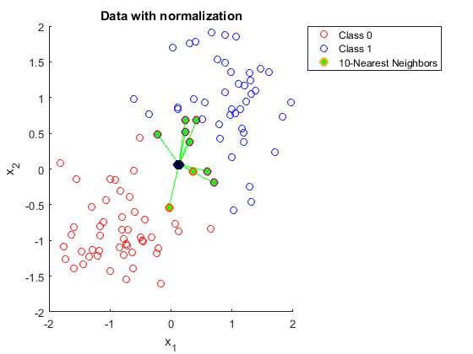
Why do you need to scale data in KNN
https://stats.stackexchange.com/questions/287425/why-do-you-need-to-scale-data-in-knn

Slide 21
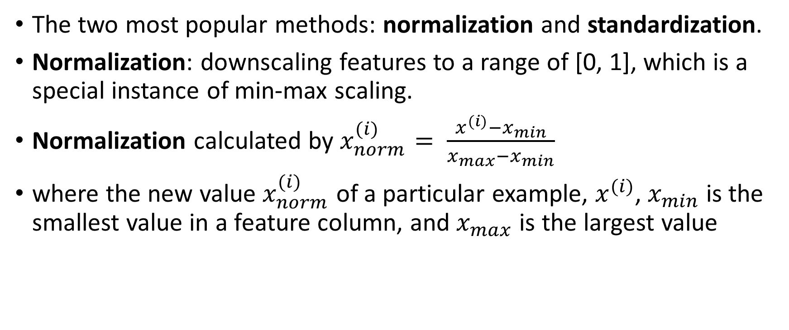
Feature scaling
The two most popular methods: normalization and standardization.
Normalization: downscaling features to a range of [0, 1], which is a special instance of min-max scaling.
Normalization calculated by $x_{norm}^{(i)}= \frac{x^{(i)}−x_{min}}{x_{max}−x_{min}}$
where the new value $x_{norm}^{(i)}$ of a particular example, $x^{(i)}$, $x_{min}$ is the smallest value in a feature column, and $x_{max}$ is the largest value

Slide 22
Standardization
Standardization can be more useful, especially for optimization algorithms like gradient descent.
Many linear models initialize the weights to zero or small random values that are close to zero, like the logistic regression and SVM.
Standardization center data at mean 0 and standard deviation 1.

Slide 23
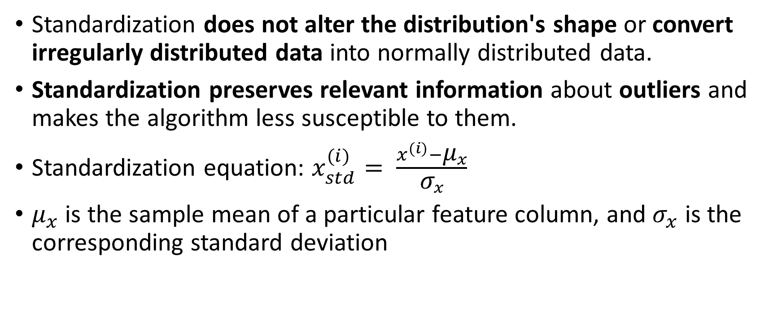
Standardization vs Normalization
Standardization does not alter the distribution's shape or convert irregularly distributed data into normally distributed data.
Standardization preserves relevant information about outliers and makes the algorithm less susceptible to them.
Standardization equation: $x_{std}^{(i)}= \frac{x^{(i)}−{\text{μ}}_{x}}{{\text{σ}}_{x}}$
${\text{μ}}_{x}$ is the sample mean of a particular feature column, and ${\text{σ}}_{x}$ is the corresponding standard deviation

Slide 24
Standardized and Normalized
Sample dataset comprised of numbers 0 to 5, the following table demonstrates the distinction between the standardization and normalization:
Input | Standardized | Min-max normalized
0.0 | -1.46385 | 0.0
1.0 | -0.87831 | 0.2
2.0 | -0.29277 | 0.4
3.0 | 0.29277 | 0.6
4.0 | 0.87831 | 0.8
5.0 | 1.46385 | 1.0

Slide 25
Unscaled vs scaled data

Slide 26
Standardization vs Normalization Clearly Explained!
https://youtu.be/sxEqtjLC0aM?si=3jcH0QHV42WKoo15

Slide 27
Feature Selection

Slide 28
Overfitting solutions
The reason for the overfitting is because our model is too complex for the available training data.
The following are some common solutions for reducing generalization error:
Obtain additional training data;
Implement a penalty for complexity through regularization;
Select a simpler model with fewer parameters;
Reduce the dimensionality of the data.
Dimensionality reduction via feature selection is an alternate method for reducing model complexity and avoid overfitting.
https://youtube.com/shorts/y_SzhZoWTSc?si=wjHFH9cP01XXR1oG

Slide 29
Univariate statistics
In univariate statistics, we determine whether each feature has a statistically significant association with the target.
The features associated with the highest level of confidence are then chosen using analysis of variance (ANOVA).
The fundamental aspect of these tests is that they are univariate, which means that they only assess each feature separately.
If a feature is only informative when paired with other features, it will be removed.

Slide 30
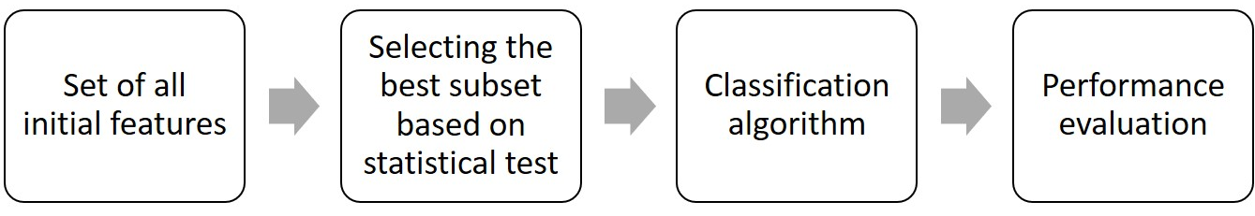
Univariate statistics
Eliminate all features with excessively high p-values (indicating that they are unlikely to be connected to the target).
SelectKBest selecting a defined number of k features
SelectPercentile selecting a fixed percentage of features being the simplest.
Filter method feature Selection steps

Slide 31
Model-Based Feature Selection
Model-driven feature selection preserves just the most crucial features after supervised machine learning models have evaluated each feature's significance.
The supervised model that was used for feature selection may or may not be the same model that is used for final modeling.
For each feature to be rated based on its importance, feature selection models must provide some measure of that importance.

Slide 32
Model-Based Feature Selection
The feature_importances_ attribute, which explicitly encodes each feature's importance, is provided by decision trees and models built on decision trees (Random Forest, Gradient Boosted Tree).
Coefficients in linear models can be used to quantify the relevance of a feature by taking absolute values into account.

Slide 33
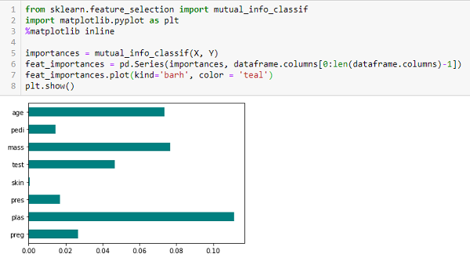
Feature Importances
https://www.analyticsvidhya.com/blog/2020/10/feature-selection-techniques-in-machine-learning/

Slide 34
Iterative Feature Selection
A variety of models are constructed with variable numbers of features during iterative feature selection.
There are two fundamental approaches: starting with no features and gradually adding features until a stopping requirement is met,
or starting with all features and gradually deleting features until a stopping criterion is met.

Slide 35
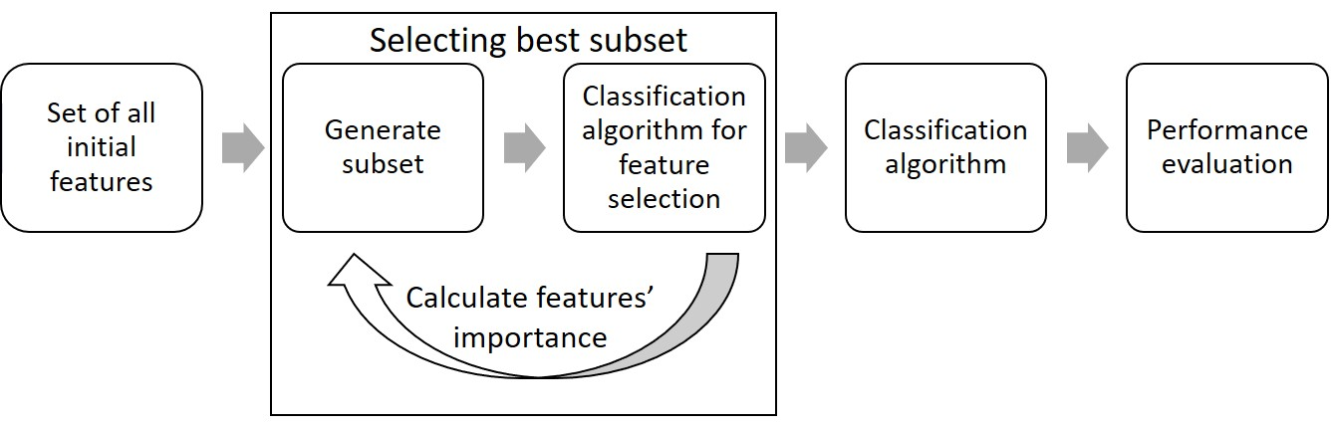
Iterative Feature Selection
Recursive feature elimination (RFE), a unique technique of this kind, starts with all the characteristics, constructs a model, and then eliminates the features that the model deems to be of the least importance.
After that, a new model is created utilizing everything but the features that were eliminated, and so on, until only a set amount of features are left.
Wrapper method feature selection steps

Slide 36
Feature Selection in Machine Learning: Easy Explanation for Data Science Interviews
https://youtu.be/7tW29jBceRw?si=GEeQUMPMtRuCoh2S

Slide 37
Grid Search & Cross Validation

Slide 38
Grid Search
Finding crucial model parameter values that offer the best generalization performance is required for practically all models and datasets.
Grid search, the most popular technique, basically means attempting all possible combinations of the given parameters.

Slide 39
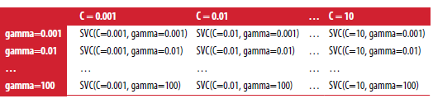
Grid Search
Consider the case of an SVM kernel with an RBF (radial basis function) kernel, as implemented in the SVC class
There are two important parameters: kernel, gamma parameter, regularization parameter, C.

Slide 40
Naïve Grid Search
from sklearn.svm import SVC
best_score = 0
for gamma in [0.01,0.1,1,10,100]:
for C in [0.01,0.1,1,10,100]:
svm = SVC(gamma=gamma,C=C)
svm.fit(X_train,y_train)
score = svm.score(X_test,y_test)
if score > best_score:
best_score = score
best_params = {'C':C,'gamma':gamma}
print("Best score:{:.2f}",format(best_score))
print("Best parameters:{}",format(best_params))
Is it valid?
No, test data supposed to simulate unseen data!
Not to choose the best params.

Slide 41
Dangers of Overfitting Parameters and Validation Sets
To address this issue, one solution is to divide the data once more into three sets as follows:
Training set for creating the model,
Selecting model parameters (or development) is the goal of validation set,
Test set to gauge the effectiveness of the chosen parameters

Slide 42
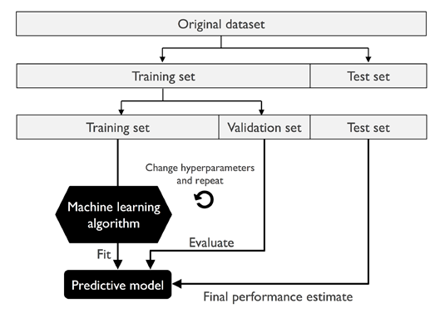
How to use train, validation, and test set

Slide 43
Dangers of Overfitting Parameters and Validation Sets
We may recreate the model using the parameter settings we discovered after choosing the best parameters using the validation set.
However, training will now be done using both the training data and the validation data.

Slide 44
Machine Learning Fundamentals: Cross Validation
https://youtu.be/fSytzGwwBVw?si=fKYWJMV-XhXvZQV2

Slide 45
Cross-Validation
More reliable and complete than train-test splitting
The model is continually trained using the segmented data.
K-fold cross-validation, in where k is a user-defined number, is the most widely used variant.
Prior to completing 5-fold cross-validation, the data is divided into five folds that are roughly equal in size. 10-fold the data is divided into 10 folds.

Slide 46
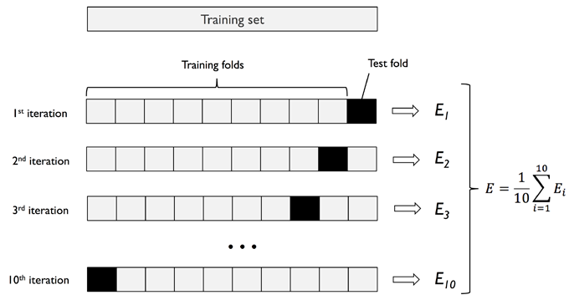
How k-fold cross-validation works

Slide 47
Cross-Validation
Advantages of Cross-Validation: each sample will have the opportunity to be in the train or test set in each fold, so data use is more effective
Disadvantages: increased computational load

Slide 48
Stratified k-Fold Cross-Validation
Splitting a data set into multiple folds may not always be a good idea
If 90% of your samples belong to class A and 10% of your samples belong to class B,
then stratified k-fold ensures that in each fold, 90% of the samples belong to class A and 10% of the samples belong to class B

Slide 49
Stratified k-Fold Cross-Validation

Slide 50
Grid Search with Cross-Validation
For better estimation of generalization performance, we can use cross-validation to evaluate the performance of each parameter combination
To evaluate the accuracy of SVM using certain C and gamma settings using 5-fold cross-validation, we need to train 25 * 5 = 125 models

Slide 51
Grid Search with Cross-Validation
from sklearn.svm import SVC
from sklearn.model_selection import cross_val_score
import numpy as np
X_trainval, X_test, y_trainval, y_test = train_test_split(X,y,test_size=0.25,random_state=0)
svmbest_score = 0

Slide 52
Grid Search with Cross-Validation
Is it valid?
Yes, train-validation set used as in cross-validation!
CV scores used to determine the best params.
for gamma in [0.01,0.1,1,10,100]:
for C in [0.01,0.1,1,10,100]:
svm = SVC(gamma=gamma,C=C)
cvscores = cross_val_score(svm,X_trainval,y_trainval,cv=5)
scoresvm = np.mean(cvscores)
if scoresvm > svmbest_score:
svmbest_score = scoresvm
best_params = {'C':C,'gamma':gamma}
svmfinal = SVC(**best_params)
svmfinal.fit(X_trainval,y_trainval)
print("Best score cross-val:{}".format(svmbest_score))
print("Best parameters:{}".format(best_params))
print("Test score:{}".format(svmfinal.score(X_test,y_test)))
Best params used on model and trained once again on the full train-validation set.
Test set used as “unseen data” to simulate model performance in real world.

Slide 53
Grid Search with Cross-Validation
For each parameter setting (only some are shown), five accuracy values were calculated, one for each split in the cross-validation
Then the average validation accuracy is calculated for each parameter setting
The parameters with the highest average validation accuracy are selected

Slide 55
Grid Search with Cross-Validation

Slide 56
Pipeline

Slide 57
Why we need pipeline?
Using data preprocessing outside the cross-validation loop causes the split data/fold in cross-validation to no longer correctly reflect how the new data will look in the modeling process.
We have leaked information from the validation data section into the modeling process.
This will lead to overly optimistic results during cross-validation, and possibly suboptimal parameter selection.
Any process that extracts knowledge from a dataset should only be applied to part of the train set.

Slide 58
If preprocessing outside CV loop
The information from validation fold is
Leaked through the scaler fit process!

Slide 59
Impact of information leakage
The impact of information leakage in cross-validation varies, depending on the nature of the preprocessing step.
Estimating data scaling using test folds usually has no negative impact, while using test folds in feature extraction and feature selection can cause substantial differences in results.

Slide 60
What should be done (using pipeline and CV)
The information from validation fold is
safe because the scaler fit process only on train folds!

Slide 61
What is pipeline?
The Pipeline class is a class that allows us to "stick" multiple processing steps into one estimator.
The Pipeline class itself has fit, predict, and score methods; and behaves like any other model in scikit-learn.
The most common use case of the Pipeline class is in chaining preprocessing steps (such as data scaling) together with a classifier model.

Slide 62
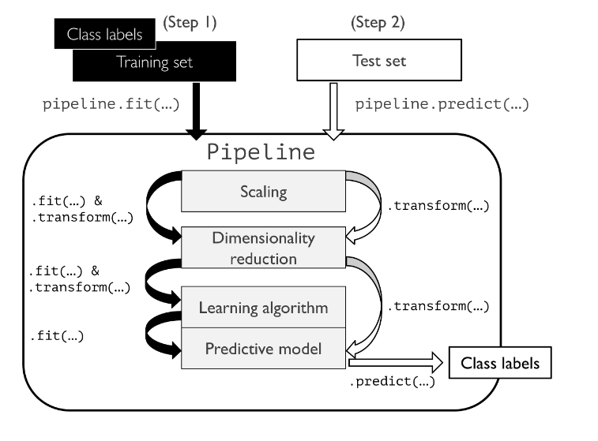
Pipeline example
https://vitalflux.com/sklearn-machine-learning-pipeline-python-example/

Slide 63
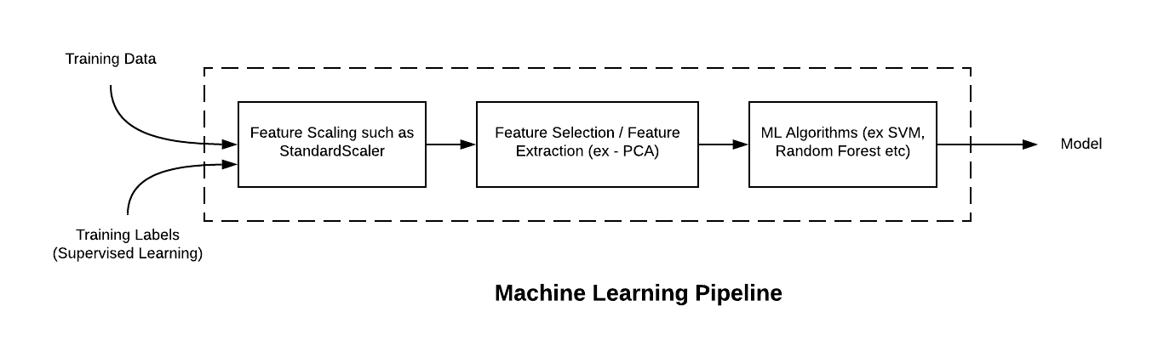
Pipeline-Training
https://vitalflux.com/sklearn-machine-learning-pipeline-python-example/

Slide 64
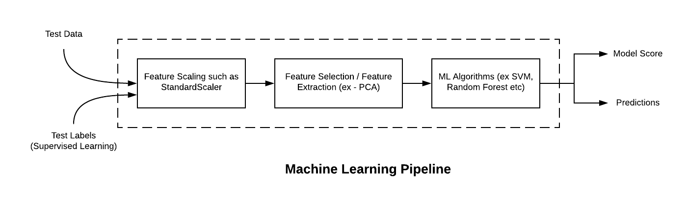
Pipeline-Testing
https://vitalflux.com/sklearn-machine-learning-pipeline-python-example/

Slide 65
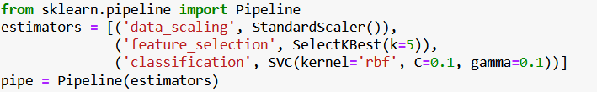
How to use pipeline: simple example!

Slide 66
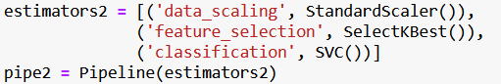
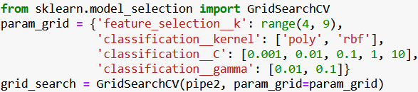
How to use pipeline: standard example!

Slide 67
Model Evaluation

Slide 68
Keep the End Goal in Mind
When selecting a metric, you should always have the end goal of the machine learning application in mind
In practice, we are usually interested not just in making accurate predictions, but in using these predictions as part of a larger decision making process
Before picking a machine learning metric, you should think about the high-level goal of the application, often called the business metric

Slide 69
Model evaluation process
The machine learning model evaluation process is carried out after the training process.
The evaluation process can use the most common metric called accuracy.
Accuracy measures the degree of agreement between predictions and original labels.

Slide 70
Metrics for Binary Classification
Remember that for binary classification, we often speak of a positive class and a negative class, with the understanding that the positive class is the one we are looking for
Kinds of errors
False Positive
a healthy patient will be classified as sick, leading to additional testing
False Negative
a sick patient will be classified as healthy, and will not receive further tests and treatment

Slide 71
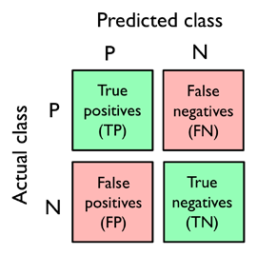
Confusion matrix

Slide 72
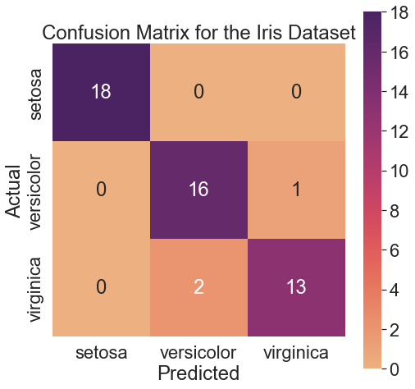
Confusion matrix
Imagine we have 50 iris instances in test set and here is the model’s prediction results…
https://scottminer.rbind.io/post/multi-class-confusion-matrix/

Slide 73
Evaluation Metrics
Accuracy: the number of correct predictions (TP and TN) divided by the number of all samples (all entries of the confusion matrix summed up)
Accuracy = (TP+TN)/(TP+TN+FP+FN)
Precision or positive predictive value (PPV): Measures how many of the samples predicted as positive are actually positive
Precision is used as a performance metric when the goal is to limit the number of false positives
Precision = TP/(TP+FP)

Slide 74
Evaluation Metrics
Recall or sensitivity, hit rate, or true positive rate (TPR): measures how many of the positive samples are captured by the positive predictions
Recall is used as performance metric when we need to identify all positive samples; that is, when it is important to avoid false negatives
Recall = TP/(TP+FN)

Slide 75
Confusion matrix
Accuracy = (TP+TN)/(TP+TN+FP+FN)
Accuracy = (18+16+13)/(18+16+1+2+13) = 47/50 = 94%
Precision = TP/(TP+FP)
Setosa precision = 18/(18+0) = 100%
Versicolor precision = 16/(16+2) = 16/18 = 89%
Virginica precision = 13/(13+1) = 13/14 = 93%

Slide 76
Confusion matrix
Recall = TP/(TP+FN)
Setosa recall = 18/(18+0) = 100%
Versicolor recall = 16/(16+1) = 16/17 = 94%
Virginica recall = 13/(13+2) = 13/15 = 87%

Slide 77
ROC curve
ROC (Receiver Operating Characteristic) curve is a graphical representation of the performance of the binary classifier at different classification thresholds.
It plots the true positive rate (TPR) and the false positive rate (FPR) at different thresholds.
TPR: The percentage of positive instances correctly identified by the classification of all actual positive cases (TP/(TP + FN)).
FPR: the percentage of negative cases incorrectly identified by the classifier from all actual negative cases (FP / (TN + FP))

Slide 78
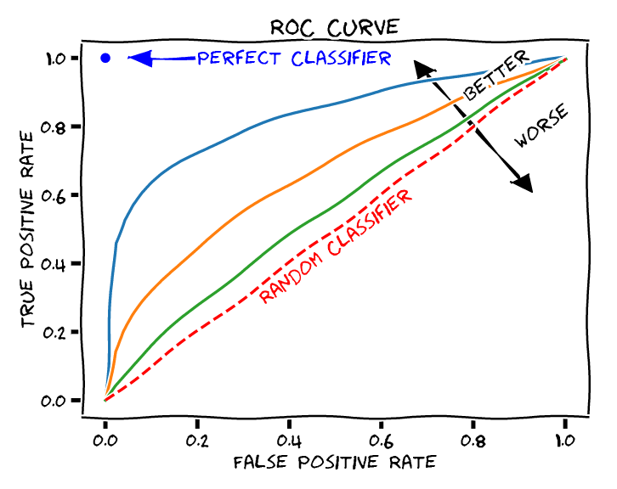
ROC curve
The curve shows the balance between sensitivity (TPR) and specificity (FPR).
A classifier with a curve closer to the upper left corner shows better performance because it means fewer false positives and more real positives.
This Photo by Unknown Author is licensed under CC BY

Slide 79
AUC
AUC is the area below the ROC curve and represents the probability that a randomly selected positive example is higher than a randomly selected negative example.
The AUC score runs from 0 to one, where:
AUC = 1: The classifier has flawless performance, distinguishing between positive and negative classifications.
AUC = 0.5: chance performance, indicating that the classifier performs no better than chance guessing.
AUC > 0.5: Higher than random performance, indicating some predictive potential.

Slide 80
AUC
An AUC score greater than 0.8 is generally considered good, while a score greater than 0.9 is regarded as excellent. However, the model's usefulness is determined by the particular problem and use situation.
The points on the ROC curve closest to (0,1) show the best-performing thresholds for the current model; picking the proper threshold depends on the value of true positives against false positives in the specific application.
ROC Curve and AUC Value: https://youtu.be/QBVzZBsif20?si=pw_UAaV9aNus7-XQ

Slide 81
What metrics to choose? A thought for class imbalance
Class imbalance is a frequent problem when working with real-world data—examples from one or more classes are over-represented in a dataset. This could happen in a variety of sectors, including spam filtering, fraud detection, and illness screening.
Assume that a dataset of disease contained 90% healthy patients. Training a model on such a dataset and achieving about 90% test accuracy would imply that our model has learned nothing significant from the features in this dataset.

Slide 82
What metrics to choose? A thought for class imbalance
When fitting classifiers on such datasets, focus on metrics other than accuracy when comparing multiple models, such as precision, recall, the ROC curve—whatever is most important in our application.
If our aim is to detect the majority of sick patients in order to urge extra screening, recall should be our preferred statistic.
Precision may be a more relevant metric in spam filtering, because we don't want to categorize emails as spam if the system isn't confident.

Slide 83
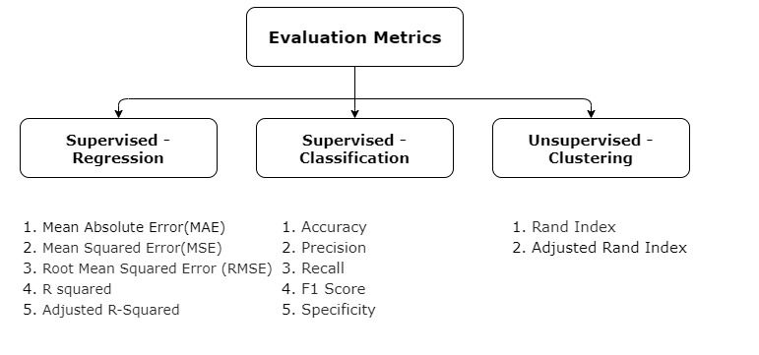
https://www.analyticsvidhya.com/blog/2022/09/get-to-know-all-about-evaluation-metrics/

Slide 84
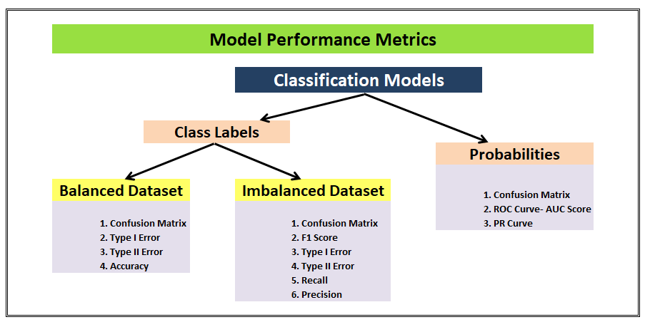
https://www.markovml.com/blog/key-machine-learning-metrics-for-assessing-model-performance
https://towardsdatascience.com/top-10-model-evaluation-metrics-for-classification-ml-models-a0a0f1d51b9

